Slide 1
CHM202: Energetics and dynamics of chemical reactions
Fugacity and activity
Slides for online lectures
Must be followed along with recommended textbook by Atkins (8th or later edition) or any other reference book
(figures/texts taken from Atkins’ Physical Chemistry, 8th Ed)

Slide 2
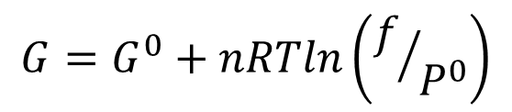

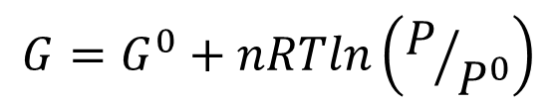
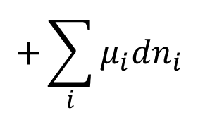
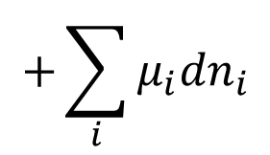
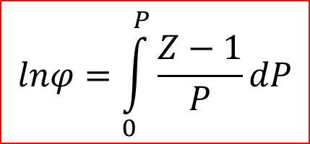


$$+\sum_{i}{μ_{i}{dn}_{i}}$$
$$dU=TdS−PdV$$
Reversible change
$$+\sum_{i}{μ_{i}{dn}_{i}}$$
$$dG=−SdT+VdP$$
Reversible change
$$G=G^{0}+nRTln\left(P/{P^{0}}\right)$$
Reversible change, constant temp, ideal gas
$$G=G^{0}+nRTln\left(f/{P^{0}}\right)$$
f: fugacity
Reversible change, constant temp, ALL gases
$$f=φ×P$$
$$lnφ=\int_{0}^{P}{\frac{Z−1}{P}dP}$$

Slide 3
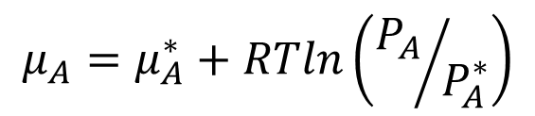

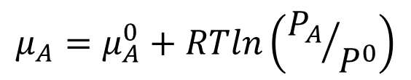
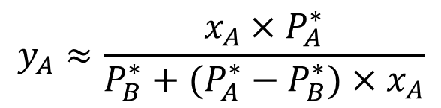


$$μ_{A}=μ_{A}^{0}+RTln\left({P_{A}}/{P^{0}}\right)$$
Reversible change, constant
Temp, ideal vapour
Vapour
A + B
y_{A} + y_{B} = 1
P_{A} & P_{B}
$$μ_{A}=μ_{A}^{∗}+RTln\left({P_{A}}/{P_{A}^{∗}}\right)$$
Exact! (no approximation yet
other than vapour behaves ideally)
Liquid
A + B
x_{A} + x_{B} = 1
$${P_{A}≈x}_{A}×P_{A}^{∗}$$
Raoult’s Law (Ideal solution)
Solvent in almost pure form
$$μ_{A}≈μ_{A}^{∗}+RTlnx_{A}$$
$$y_{A}≈\frac{x_{A}×P_{A}^{∗}}{P_{B}^{∗}+(P_{A}^{∗}−P_{B}^{∗})×x_{A}}$$
Henry’s Law
(“Ideal” dilute solution)
Solute in low concentration
$${P_{B}≈x}_{B}×K_{B}$$

Slide 4



Ideal solution
$${P_{A}≈x}_{A}×P_{A}^{∗}$$
Raoult’s Law is followed
by A at ALL concentrations
$$μ_{A}≈μ_{A}^{∗}+RTlnx_{A}$$
Raoult’s Law is followed
by B at ALL concentrations
$$μ_{B}≈μ_{B}^{∗}+RTlnx_{B}$$

Slide 5
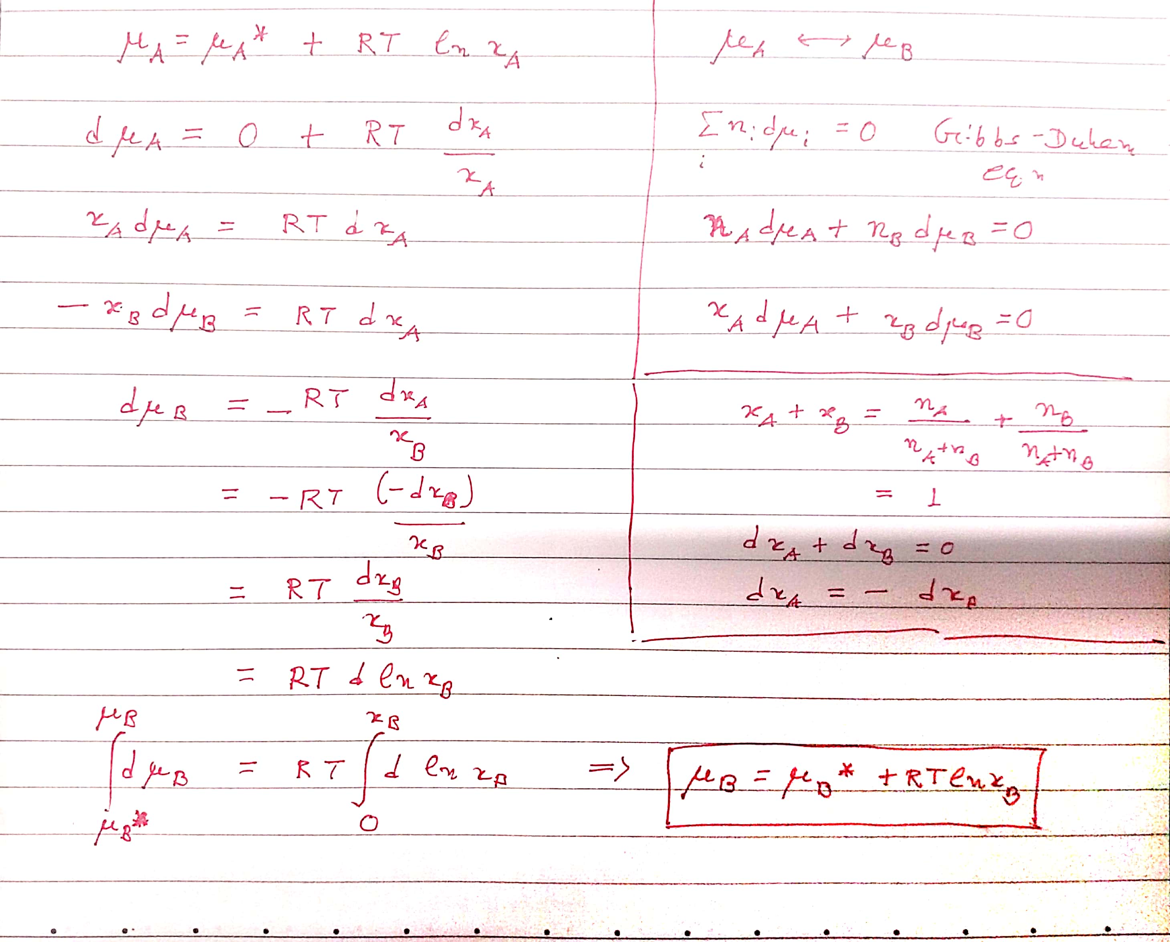

Slide 6
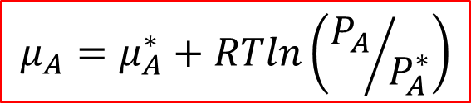


Ideal solution
$${P_{A}≈x}_{A}×P_{A}^{∗}$$
Raoult’s Law is followed
by A at ALL concentrations
$$μ_{A}≈μ_{A}^{∗}+RTlnx_{A}$$
Raoult’s Law is followed
by B at ALL concentrations
$$μ_{B}≈μ_{B}^{∗}+RTlnx_{B}$$
Real solution
$$μ_{A}=μ_{A}^{∗}+RTln\left({P_{A}}/{P_{A}^{∗}}\right)$$
Raoult’s Law is
followed by A or B
in almost pure form
(x_{A} or x_{B} → 1)
$$μ_{B}=μ_{B}^{∗}+RTln\left({P_{B}}/{P_{B}^{∗}}\right)$$
$${P_{B}≈x}_{B}×K_{B}$$
Henry’s Law is followed by A or B
in low concentration (x_{B} → 0)

Slide 7

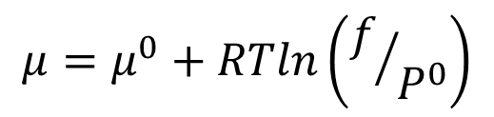

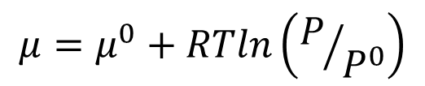

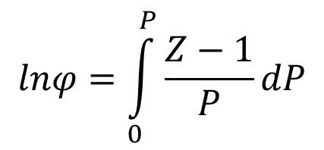
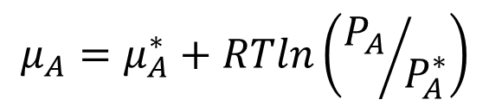


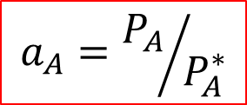
Phase
Approximation
Exact equation
$$μ=μ^{0}+RTln\left(P/{P^{0}}\right)$$
$$μ=μ^{0}+RTln\left(f/{P^{0}}\right)$$
f: fugacity
Gas/Vapour
when P → 0
$$f=φ×P$$
f → P or φ → 1 when P → 0
$$lnφ=\int_{0}^{P}{\frac{Z−1}{P}dP}$$
$${P_{A}≈x}_{A}×P_{A}^{∗}$$
$$μ_{A}=μ_{A}^{∗}+RTln\left({P_{A}}/{P_{A}^{∗}}\right)$$
$$μ_{A}≈μ_{A}^{∗}+RTlnx_{A}$$
$$μ_{A}=μ_{A}^{∗}+RTlna_{A}$$
a: activiity
when x_{A} → 1
Liquid (solution):
Solvent
$$a_{A}=γ_{A}×x_{A}$$
a_{A}→ x_{A} or γ_{A} → 1 when x_{A} → 1
$$a_{A}={P_{A}}/{P_{A}^{∗}}$$

Slide 8

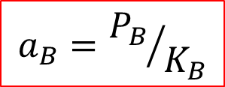
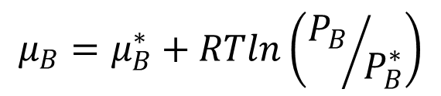
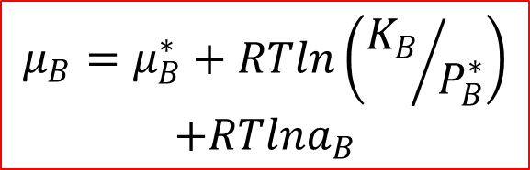

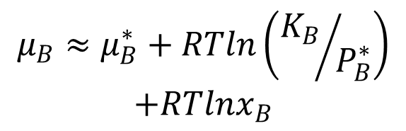
Phase
Approximation
Exact equation
$$μ_{B}=μ_{B}^{∗}+RTln\left({P_{B}}/{P_{B}^{∗}}\right)$$
$${P_{B}≈x}_{B}×K_{B}$$
$$μ_{B}≈μ_{B}^{∗}+RTln\left({K_{B}}/{P_{B}^{∗}}\right)$$
$$+RTlnx_{B}$$
when x_{B} → 0
$$μ_{B}=μ_{B}^{∗}+RTln\left({K_{B}}/{P_{B}^{∗}}\right)$$
$$+RTlna_{B}$$
Liquid (solution):
Solute
a: activiity
$$a_{B}=γ_{B}×x_{B}$$
a_{B}→ x_{B} or γ_{B} → 1 when x_{B} → 0
$$a_{B}={P_{B}}/{K_{B}}$$

Slide 9
Activity of regular solution:
Margules equation

